Slide 1
Biomass
PowerPoint presentation
Unit 301: Understand the fundamental principles and requirements of environmental technology systems

Slide 2
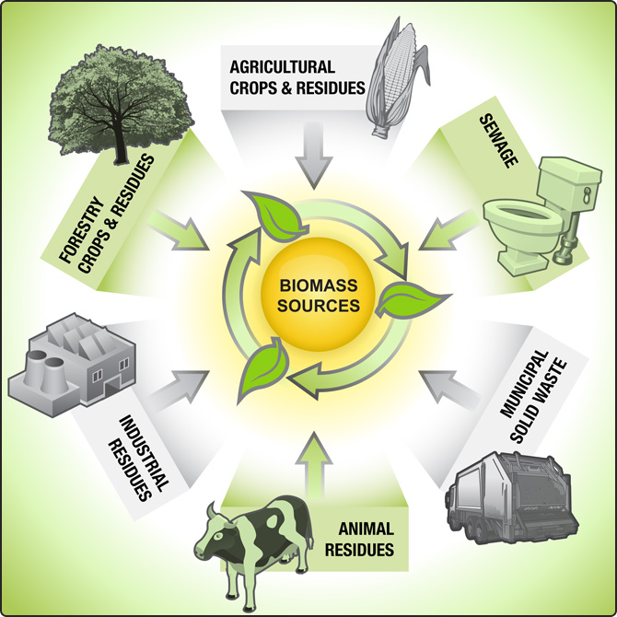
Biomass
Biomass is biological material derived from living, or recently living organisms.
In the context of biomass for energy this is often used to mean plant based material, but biomass can equally apply to both animal and vegetable derived material.

Slide 3
Biomass
Biomass is a renewable, low carbon fuel that is already widely available throughout the UK.
Its production and use also brings additional environmental and social benefits.
Correctly managed, biomass is a sustainable fuel that can deliver a significant reduction in net carbon emissions when compared with fossil fuels.

Slide 4
Biomass
There is no reason why the production and use of biomass can't be sustainable.
The main source of biomass in the UK is timber from forestry, which falls under the remit of the Forestry Act (1967).

Slide 5
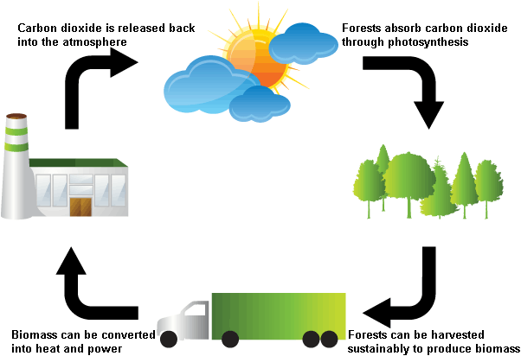
Biomass vs. fossil fuels
The vital difference between biomass and fossil fuels is one of time scale.
Biomass takes carbon out of the atmosphere while it is growing, and returns it as it is burned.
If it is managed on a sustainable basis, biomass is harvested as part of a constantly replenished crop.

Slide 6
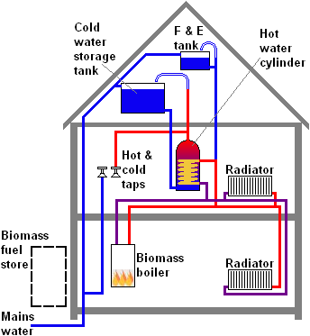
Biomass systems
Wood-fuelled domestic heating systems are also called biomass systems; they burn wood pellets, chips or logs to provide warmth in a single room or to power central heating and hot water boilers.

Slide 7
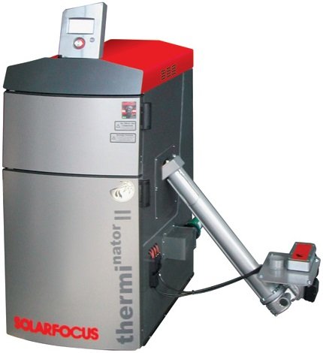

Slide 8
Building Regulations requirements
In England and Wales installation work relating to domestic solid fuel, wood and biomass and the associated systems for heating, controls, hot water, etc are subject to Building Regulations.
The Approved Documents F, J, L, G, P are applicable and most work is notifiable to the relevant Local Authority.

Slide 9
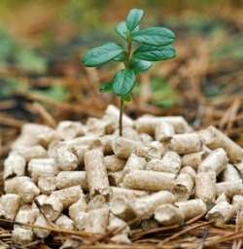
Advantages of biomass
Biomass is a sustainable fuel source if managed correctly, ie trees need to be planted to replace those used.
It's virtually carbon neutral.
If biomass boilers are well maintained and run they will produce very little smoke.
Biomass is a good way of using up waste wood.
Biomass fuels are less susceptible to price increases than traditional fuels such as oil and gas.
If you replace a coal or electric heating system with biomass you can reduce your carbon dioxide output by around 9.5 tonnes per annum.

Slide 10
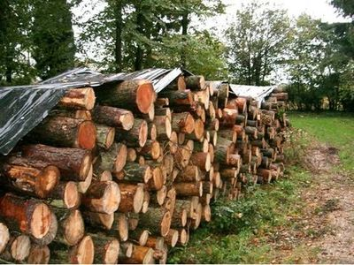

Slide 11
Any questions?

